Slide 1
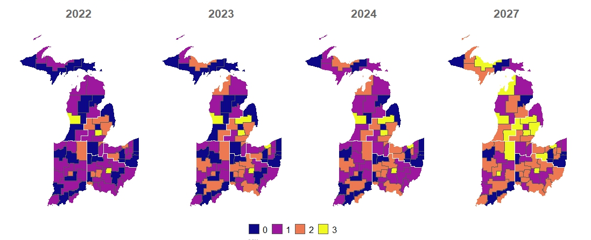
MIDWESTERN STATES CLUSTER ADVANCEMENT FORECAST
RIDVAN
RIDVAN
RIDVAN
RIDVAN
MILESTONE

Slide 2
INDIANA SUB-REGION
Sub-Region | Cluster | Cluster Name | 2023 | 2024 | 2027
Indiana | IN-01N | Indy North |  |  | M1 to M2
Indiana | IN-01S | Indy South |  |  | M0 to M1
Indiana | IN-02 | Fort Wayne |  |  | M2 to M3
Indiana | IN-03 | South Bend Area |  |  | M1 to M2
Indiana | IN-04 | W Lafayette | M1 to M2
Indiana | IN-05 | Hollow Reed (Bloomington) | M1 to M2
Indiana | IN-06 | Gary |  |  | M1 to M2
Indiana | IN-07 | Evansville |  |  | M1 to M2
Indiana | IN-10 | Kokomo |  | M0 to M1
Indiana | IN-12 | Vincennes |  |  | M0 to M1
Indiana | IN-13 | Richmond |  |  | M1 to M2
Indiana | IN-17 | Clark, Floyd, Harrison Co |  | M1 to M2

Slide 3
MICHIGAN E SUB-REGION
Sub-Region | Cluster | Cluster Name | 2023 | 2024 | 2027
Michigan E | MI-07 | Thumb Area Counties |  |  | M0 to M1
Michigan E | MI-08 | Davison-Flint | M2 to M3
Michigan E | MI-11 | Lansing Area |  |  | M2 to M3
Michigan E | MI-15 | Adrian/Monroe | M1 to M2
Michigan E | MI-16 | Livingston County (Brighton) |  |  | M0 to M1
Michigan E | MI-19 | Tri-County |  |  | M2 to M3
Michigan E | OH-21 | Williams |  | M0 to M1

Slide 4
MICHIGAN N/W SUB-REGION
Sub-Region | Cluster | Cluster Name | 2023 | 2024 | 2027
Michigan N/W | MI-04 | Central Michigan Counties |  | M0 to M1 | M1 to M2
Michigan N/W | MI-06 | Midland/Bay City/Saginaw |  |  | M1 to M2
Michigan N/W | MI-12 | St Joseph/Benton Harbor Area |  | M0 to M1 | M1 to M2
Michigan N/W | MI-13 | Kalamazoo Area | M1 to M2 |  | M2 to M3
Michigan N/W | MI-31 | Ionia Area |  |  | M0 to M1
Michigan N/W | MIUP-02 | Houghton |  |  | M1 to M2
Michigan N/W | MIUP-03 | Escanaba |  | M0 to M1 | M1 to M2
Michigan N/W | MIUP-04 | Marquette | M1 to M2 |  | M2 to M3
Michigan N/W | MIUP-06 | Sault Ste Marie |  | M0 to M1

Slide 5
OHIO N SUB-REGION
Sub-Region | Cluster | Cluster Name | 2023 | 2024 | 2027
Ohio N | OH-01 | Emerald (Cuyahoga-Cleveland) | M2 to M3
Ohio N | OH-07 | Summit Co (Akron) | M1 to M2
Ohio N | OH-09 | Ashtabula/Trumbull |  |  | M0 to M1
Ohio N | OH-10 | Lorain Co (Oberlin) |  |  | M1 to M2
Ohio N | OH-11 | Portage Co |  |  | M1 to M2
Ohio N | OH-14 | Stark Co |  |  | M1 to M2
Ohio N | OH-22 | Ottawa Co |  | M1 to M2
Ohio N | OH-24 | Crawford |  |  | M2 to M3

Slide 6
OHIO S SUB-REGION
Sub-Region | Cluster | Cluster Name | 2023 | 2024 | 2027
Ohio S | OH-18 | Appalachia I |  |  | M1 to M2
Ohio S | OH-19 | Muskingum |  | M0 to M1
Ohio S | OH-20 | Athens |  |  | M1 to M2
Ohio S | OH-26 | Allen |  |  | M0 to M1
Ohio S | OH-27 | Wyandot | M1 to M2
Ohio S | OH-28 | Morrow |  |  | M1 to M2
Ohio S | OH-29 | Darke | M1 to M2
Ohio S | OH-33 | Warren |  |  | M1 to M2
Ohio S | OH-35 | Appalachia III | M1 to M2

